Slide 1
Experimental investigation of flexural behaviour of rcC beam embedded with pvc pipe filled with waste crumbled rubber powder

Slide 2
BATCH MEMBERS
SILVER GRAHAM PETER W 110318103006
KAMALESH J S 110318103002
NAVEEN KUMAR S 110318103005
PROJECT GUIDE
Mr.D.ARIVUKKARASU M.E.,
Assistant Professor / Civil
GRT IET

Slide 3
ABSTRACT
This project works is to investigate the flexural behaviour of concrete beams strengthened using rubber powder-filled via PVC pipe.
One of the beams is used as a control beam (conventional beam) while the remaining beams were strengthened before testing to failure under flexural loading.
The results may show that the rubber powder-filled beam weight may reduce and strength may increase because due to the rubber powder in the centre of the beam, the seismic load may withstand this due to the little deformation by the rubber powder.
The ultimate and service load of the strengthened beams were increased. The strengthening of beams with rubber powder may enhance their stiffness.
Modification factors for flexural strength beam may get strengthened using rubber powder may be proposed from this project works.

Slide 4
INTRODUCTION
Cement and aggregate are the most important constituents used in concrete production and are the vital materials needed for the construction industry.
To reduce the dumping of waste material, utilize them as raw materials in construction industry.
Waste rubber from lorry tyre and bicycle tyre has received a great deal of attention for utilization because of its large production volume and difficulty of disposal.
This rubber is grinded into fine size rubber crumbs and compacted inside the PVC pipe. and the rubber filled PVC pipe is placed inside the reinforcement concrete so that the neutral axis of the concrete touches the mid-point of the rubber filled PVC pipe.

Slide 5
LITERATURE REVIEW

Slide 6
MOSTAFA FAKHARIFAR A , GENDA CHEN,”FRP-CONFINED CONCRETE FILLED PVC TUBES: A NEW DESIGN CONCEPT FOR DUCTILE COLUMN CONSTRUCTION IN SEISMIC REGIONS’’, CONSTRUCTION AND BUILDING MATERIALS(17 NOVEMBER 2018).
ABSTRACT | PARAMETER | RESULT
This paper introduced and validated a new ductile design concept of confined concrete-filled polyvinyl-chloride tubular (CCFPT) columns through experimental and analytical studies the axial and flexural behavior of FRP confined concrete-filled PVC tubular columns and compares their performance with those of concrete-filled PVC tubular columns and FRP-wrapped columns. Polyvinyl-chloride (PVC) tube and fibre-reinforced polymer (FRP) wrappings or FRP with a sandwiched layer of foam to enhance impact energy reduction due to potential FRP rupture and PVC fracture. | Introduction of foam between FRP layers proved to be an effective method to lessen the brittleness, and obtainment of relatively ductile member’s response upon FRP rupture. Concrete filled PVC tube beams demonstrate ductile plastic response under flexure.’ | PVC tube contributed little to the axial strength of concrete columns, but FRP wraps with fiber oriented significantly strengthen the columns. PVC tube fractured right after the rupture of its immediate FRP wraps resulting in a sudden loss of load carrying capacity. This brittle failure mode can be prevented by introducing an energy absorption foam layer between the PVC tube and the FRP wraps PVC tube in CCFPT beams results in improved peak strength and initial stiffness

Slide 7
MINHAO DONGA , MOHAMED ELCHALAKANIA , ALI KARRECHA , MOSTAFA FAHMI HASSANEINB , TIANYU XIEC , BOYANG,”BEHAVIOR AND DESIGN OF RUBBERISED CONCRETE FILLED STEEL TUBES UNDER COMBINED LOADING CONDITIONS”,THIN-WALLED STRUCTURES(21 FEBRUARY 2019).
ABSTRACT | PARAMETER | RESULT
This paper explored the option to effectively confine the rubberized concrete with steel tubes to obtain enhanced strength and ductility. The behavior and performances of thirty rubberized concrete-filled single-skin steel tubes(CFST) of various rubber content, steel section and load eccentricities was systematically investigated in this study | The 15% rubber replacement ratio showed a good balance of strength and ductility. | The results have shown that confined rubberized concrete and the restrained steel tube improved ductility of the composite section. The rubberized concrete was more effective in delaying the premature buckling failure of the steel tube compared to the more brittle normal cement concrete. It is recommended to confine RuC with steel tubular sections in the future construction as flexible roadside barriers, and beams and columns in buildings in seismic active zones

Slide 8
MD. SHAHJALAL A , KAMRUL ISLAM A, B , JESIKA RAHMAN A, D , KHONDAKER SAKIL AHMED A , MOHAMMAD REZAUL KARIM C , AHM MUNTASIR BILLAH D,”FLEXURAL RESPONSE OF FIBER REINFORCED CONCRETE BEAMS WITH WASTE TIRES RUBBER AND RECYCLED AGGREGATE”,JOURNAL OF CLEANER PRODUCTION (26 AUGUST 2020).
ABSTRACT | PARAMETER | RESULT
This deals with both different structural and non-structural applications. The use of RCA and CR as replacements of natural aggregates will contribute to the production of a sustainable material and cleaner environment. crumb rubber (CR) derived from the waste tire and recycled coarse aggregate (RCA) in concrete production pertains to a sustainable future of the construction industry Concrete beams with 30% RCA, 5% CR and 0.5% PP(Polypropylene fiber) showed improved flexural capacity, ductility, and toughness. | This study provides a comprehensive evaluation of a sustainable concrete made with RCA, CR, and PP fiber through large scale tests on reinforced FRC beams. | The usefulness of RCA and CR in lieu of the natural aggregates in structural concrete elements is a noteworthy attempt in protecting the ecosystem The splitting tensile strength is improved as PP fiber is added, The ultimate bending moment capacity are found to be 1.5 times Both toughness and ductility values are found to be increased for CR

Slide 9
AHMED S. EISA, MOHAMED T. ELSHAZLI, MAHMOUD T. NAWAR,”EXPERIMENTAL INVESTIGATION ON THE EFFECT OF USING CRUMB RUBBER AND STEEL FIBERS ON THE STRUCTURAL BEHAVIOR OF REINFORCED CONCRETE BEAMS”, CONSTRUCTION AND BUILDING MATERIALS (5 APRIL 2020)
ABSTRACT | PARAMETER | RESULT
This journal shows the investigation for crumb rubber replacement for aggregate. concrete mixtures may differ with changes in materials characteristics, mixture proportions of the ingredients, curing procedure, and use of admixtures and additives. | Experimentally study the effect of crumb rubber and steel fibers on RC beams. Incorporating 10%, rubber improved ductility and toughness of concrete mixtures. Combining 1% steel fibers and 10%, rubber improved the performance of RC beams. | Adding of steel fibers in concrete increases the compressive strength by 11–34%, the splitting tensile strength by 96–75%, and the modulus of rupture by 26–14%, when the percentage of crumb rubber vary from 0% to 20%, respectively. Using crumb rubber as partial replacement of fine aggregates by 5% and 10% show good mechanical properties with increase in the toughness by 6% and 5%, and increase in the performance of rubberized reinforced concrete beams having rubber percentages over than 10%.

Slide 10
TRILOK GUPTA A , SALMAN SIDDIQUE B , RAVI K. SHARMA A , SANDEEP CHAUDHARY C,”BEHAVIOR OF WASTE RUBBER POWDER AND HYBRID RUBBER CONCRETE IN AGGRESSIVE ENVIRONMENT”, CONSTRUCTION AND BUILDING MATERIALS (16 MAY 2019).
ABSTRACT | PARAMETER | RESULT
The durability of waste rubber powder and hybrid (rubber powder and rubber fibers) concrete was observed. It showed good resistance against acid attack and chloride ion diffusion. acid and chloride resistance characteristics of rubber aggregate concrete make it suitable for application in chemical industrial flooring and sewage pipes | Waste rubber aggregates in fiber and powder were used in concrete. Durability properties against aggressive environment were evaluated. Improved resistance to acid and chloride attack was observed on inclusion of waste rubber aggregate. | The incorporation of rubber aggregate results in an increased probability of corrosion in concrete. The enhanced durability against chloride ion does not ensure durability against corrosion in case of rubber aggregate. The improper bond between rubber aggregate and cement paste leads to oxygen inflow which triggers corrosion in rebar. The incorporation of rubber aggregate in concrete resulted in improved resistance to mass loss under acid attack as the hydrophobic nature of rubber delayed the penetration of the acidic solution into the concrete matrix

Slide 11
MOHAMED THAMEEM ANSARI, N. SAKTHIESWARAN, O. GANESH BABU,”MATERIALS TODAY: PROCEEDINGS,”EXPERIMENTAL STUDY OF AN ECO-FRIENDLY CONCRETE BY INBUILT WITH TREATED CRUMB RUBBER”, MATERIALS TODAY: PROCEEDINGS(13 JUNE 2020).
ABSTRACT | PARAMETER | RESULT
This deals with the surface treatment process and was proposed to make solid polarity groups to rubber surface to generate a solid chemical strength among the rubber and the concrete matrix. It is an effective process to enhance the mechanical properties of concrete | Treatment reduces the segregation made the rubber to be hydrophilic and increase the adhesive strength in the concrete. The Hydro chloride acid attack test conducted on the specimens. | Over all the replacement, 2.5 percentages are efficient and effective mix, for all the three tests it gives desirable strength. the result of strength at 5% replacement gives higher strength 90% Compressive strength attains in 2.5% & 5% Exactly 100% Flexural strength attains in 2.5% replacement of Treated Crumb Rubber by comparing with Control Mix.

Slide 12
CLAUDIO DE SOUZA KAZMIERCZAK A, SAMUEL DUTRA SCHNEIDER A , ORLANDO AGUILERA A , CRISTHIANA CARINE ALBERT A , MAURÍCIO MANCIO,”RENDERING MORTARS WITH CRUMB RUBBER: MECHANICAL STRENGTH, THERMAL AND FIRE PROPERTIES AND DURABILITY BEHAVIOR”, CONSTRUCTION AND BUILDING MATERIALS (4 APRIL 2020).
ABSTRACT | PARAMETER | RESULT
The difficulties related to waste tire disposal encourage the use of crumb rubber in civil construction as a component of cement composites. In this study, crumb rubber is evaluated as a partial replacement of the aggregate in rendering mortars , in quantities of 0%, 2%, 4% and 6%, using a systemic approach. The physical and mechanical properties of the fresh and hardened mortars, thermal and fire properties and durability behavior are found. | Mortars with 6% crumb rubber are non-combustible and do not propagate flames. The increase of rubber content decreases the thermal conductivity of the mortar. Rubber mortars cracking after thermal accelerated aging is lower than the reference Use of crumb rubber in rendering mortars maintains the adhesion to ceramic substrate | At fresh state, crumb rubber mortars require a higher water content to achieve the same workability of the control mixture, decrease the bulk density and increase the water retention and air content of the mortar. The rendering mortars with 2% and 4% of crumb rubber content presented the best set of properties related to deformation capacity, thermal insulation and lower cracking, with tensile bond strength above the minimum required at standards.

Slide 13
SUMMERY OF THE LITERATURE:
PVC tube in CCFPT(confined concrete-filled polyvinyl-chloride tubular) beams results in improved peak strength and initial stiffness.
Rubberized concrete-filled single-skin steel tubes(CFST) results have shown that improved ductility, delaying the premature buckling failure and it can be used in beams and columns in buildings in seismic active zones.
Concrete beams with 30% RCA, 5% CR and 0.5% PP(Polypropylene fiber) showed improved flexural capacity, ductility, and toughness
Crumb Rubber replacement for aggregate- Incorporating 10%, rubber improved ductility and toughness of concrete mixtures. Combining 1% steel fibers and 10%, rubber improved the performance of RC beams.
The durability of waste rubber powder and hybrid (rubber powder and rubber fibers) concrete was observed. resulted in improved resistance to mass loss under acid attack as the hydrophobic nature of rubber delayed the penetration of proposed a solid chemical strength among the rubber and the concrete matrix. 2.5 percentages are efficient and effective mix which gives desirable strength.
waste tire disposal encourage the use of crumb rubber The acidic solution into the concrete matrix.the surface treatment process and was rendering mortars with 2% and 4% of crumb rubber content presented the best set of properties related to deformation capacity, thermal insulation and lower cracking, with tensile bond strength above the minimum required at standards.

Slide 14
PROBLEM STATEMENT:
When rubbers crumbs are directly mixed with concrete and casted, its leads to poor bondage between rubber and cement causing voids.
These voids tends to initiate corrosion in steel resulting in early crack formation than conventional concrete.
To overcome these issues, this project introduces PVC compacted with rubber crumb there by avoiding direct contact with concrete and also increase the ductility behaviour.

Slide 15
AIM
To investigate the flexural behaviour of the beam, which has Rubber crumbs compacted PVC pipe.
Comparing flexural strength of the conventional beam to the proposed beam.

Slide 16
OBJECTIVES
Performance evaluation of beam with PVC filled with rubber crumbs.
To minimize the overall environmental effects by incorporate waste chipped rubber to the concrete.
To study the flexural strength development of concrete with and without PVC pipe filled with rubber crumbs.

Slide 17
METHODOLOGY
Identify and selection of project area
Literature survey
Material Procurement
Testing of raw material
Mix Design
Casting of Beams
Testing & Comparison
Results & Conclusion

Slide 18
MATERIAL TESTING:
CEMENT
Standard Consistency of Cement = (Quantity of water for 5-7 mm penetration/Weight of cement) X 100
TRIAL | Quantity of cement taken in g | Quantity of water added in ml | Penetration in mm | Nominal Consistency in %
1. | 250 | 62.5 | 32 | 25
2. | 250 | 75 | 11 | 30
3. | 250 | 87.5 | 6 | 35
Average |  |  |  | 30%

Slide 19
SETTING TIME OF CEMENT
Time at which water is added to cement (min) | Time at which the needle fails to pierce the test block by 5.0±0.5mm (min) | Initial setting time (min)
0 | 45 | 45
Time at which water is added to cement (min) | Time at which the needle fails to pierce the test block by 5.0±0.5mm (min) | Final setting time (min)
45 | 310 | 310

Slide 20
DETERMINATION OF SPECIFIC GRAVITY OF CEMENT
OBSERVATION:
Initial reading of flask in ml (V₁) : 0.5ml
Final reading of flask in ml (V₂) : 19.5ml
Volume of cement particle (V₂ - V₁) : 19ml
Weight of equal volume of water in g (W₂): 19ml
Specific gravity of cement (W₁/ W₂) : 3.15

Slide 21
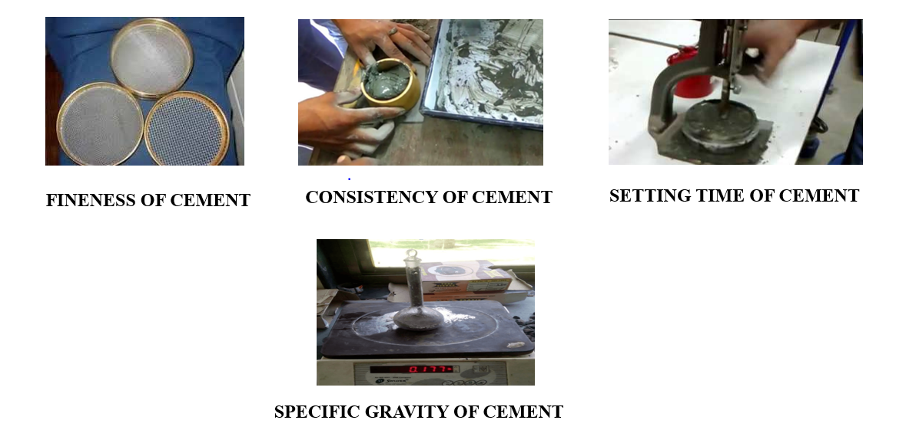
CEMENT TESTING PHOTOS

Slide 22
SIEVE ANALYSIS OF FINE AGGREGATE
Weight of fine aggregate taken (W_{f}): 500g
Sl. No. | Sieve size | Weight retained (in g) | %age retained 𝐶𝐶3 x100 𝑊𝑊_{𝑓𝑓} | Cumulative %age retained | Percentage passed (100 –C₅ )
C₁ | C₂ | C₃ | C4 | C₅ | C₆
1 | 4.75 mm | 9.4 | 1.88 | 1.88 | 98.12
2 | 2.36 mm | 10.32 | 2.06 | 3.94 | 96.06
3 | 1.18 mm | 30.78 | 6.16 | 10.1 | 89.9
4 | 600 micron | 120.94 | 24.19 | 34.29 | 65.71
5 | 300 micron | 134.12 | 26.82 | 61.11 | 38.89
6 | 150 micron | 106.53 | 21.31 | 82.42 | 17.58
7 | Pan | 82.01 | 16.40 | 98.82 | 1.18
Fineness Modulus ∑ ^{𝐶𝐶5} = 100 |  |  |  | 2.93 | -
Zone to which the fine aggregate belongs: |  |  |  | ZONE - II

Slide 23
SPECIFIC GRAVITY OF FINE AGGREGATE
Sl.no | Description(gm) | Trial1 | Trial2 | Trial3 | Mean
1 | Weight of empty bottle (M1) | 612 | 612 | 612 | 2.75
2 | Weight of bottle + Fine Aggregate(M2) | 860 | 862 | 849
3 | Weight of bottle + Fine Aggregate + water (M3) | 1608 | 1611 | 1611
4 | Weight of bottle + water (M4) | 1450 | 1450 | 1450
5 | Specific gravity of Fine Aggregate | 2.75 | 2.81 | 2.68

Slide 24
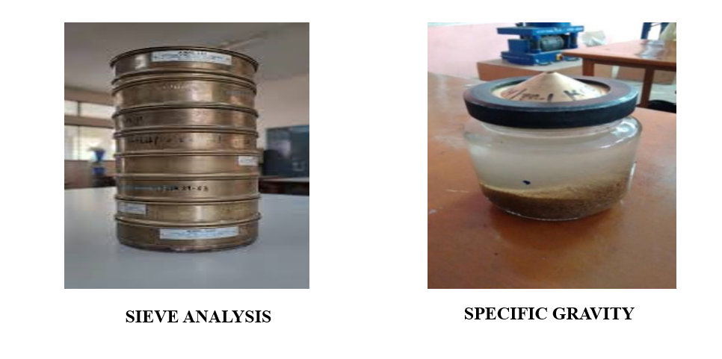
FINE AGGREGATE TESTING PHOTOS

Slide 25
SIEVE ANALYSIS OF COARSE AGGREGATE
Weight of coarse aggregate taken (W_{c}): 5Kg
Sl. No. | Sieve size | Weight retained (in kg) | %age retained 𝐶𝐶3 × 100 𝑊𝑊_{𝑐𝑐} | Cumulative %age retained | Percentage passed (100 –C₅ )
C₁ | C₂ | C₃ | C4 | C₅ | C₆
1 | 80 mm | 0 | 0 | 0 | 100
2 | 40 mm | 0 | 0 | 0 | 100
3 | 20 mm | 4.755 | 95.1 | 95.1 | 4.9
4 | 10 mm | 0.24 | 4.8 | 99.9 | 0.1
5 | 4.75 mm | 0.004 | 0.08 | 99.98 | 0.02
6 | Pan | 0.001 | 0.02 | 100 | -
Sum of cumulative percentage retained (excluding pan) ∑ 𝐶𝐶₅= |  |  |  | 494.98 | -
Fineness Modulus ∑ ^{𝐶𝐶5} + 100 |  |  |  | 4.95 | -
Grade to which the coarse aggregate belongs: |  |  |  | Well Graded

Slide 26
WATER ABSORPTION TEST
Water absorption = [(A – B)/B] x 100%.
TRIAL | Wt. of Saturated Sample in grams A | Wt. of Oven Dried Sample in grams B | %age of water absorption | Average
1. | 1080 | 1010.2 | 6.91 | 4.04
2. | 1072.9 | 1054.6 | 1.73
3. | 1036.4 | 1001.5 | 3.48

Slide 27
IMPACT TEST OF COARSE AGGREGATE
S. NO | DESCRIPTION | TRIAL 1 | TRIAL 2 | TRIAL 3
1. | Total weight of aggregate sample filling the cylinder (W₁ g) | 382 | 385 | 381
2. | Weight of aggregate passing 2.36mm sieve after the test (W₂ g) | 79.6 | 74.3 | 82.7
3. | Aggregate Impact Value (w₂/w₁) x 100% | 20.83 | 19.30 | 21.7
4. | Average Impact Value% | 20.61

Slide 28
Determination of Water Quality
S. NO | TESTS TO BE CONDUCTED | OBTAINED LIMITS | PERMISSIBLE LIMITS | REFERRED CODE BOOKS
1. | Determination of Calcium in the given water sample | 72.156 mg/l | 75mg/l | IS3025 (PART 23)
2. | Determination of Ammonia Nitrogen in the given water sample | 11.3 mg/l | 12mg/l | IS10500
3. | Determination of Chloride in the given water sample | 200mg/l | 250mg/l | IS3025 (PART 32)
4. | Determination of pH in the given water sample | 7 | 6.5 – 8.5 | IS3025 (PART 11)

Slide 29
MIX DESIGN
Grade Designation | M30
Type of cement | OPC 53grade
Fine Aggregate | Zone - II
Sp. Gravity Cement | 3.15
Sp. Gravity Fine Aggregate | 2.65
Sp. Gravity Coarse Aggregate | 2.67
Sp. Gravity GGBS | 2.84
Slump | 100 mm
1. TARGET MEAN STRENGTH:
f_{ck} = f_{ck}+ 1.65s
= 30 + (1.65 × 5)
= 38.25 N/mm²

Slide 30
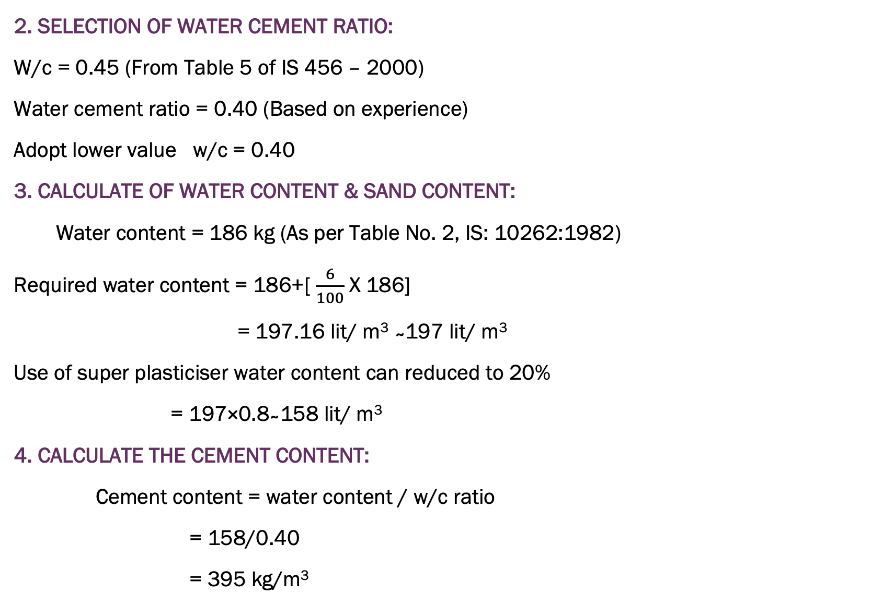
2. SELECTION OF WATER CEMENT RATIO:
W/c = 0.45 (From Table 5 of IS 456 – 2000)
Water cement ratio = 0.40 (Based on experience)
Adopt lower value w/c = 0.40
3. CALCULATE OF WATER CONTENT & SAND CONTENT:
Water content = 186 kg (As per Table No. 2, IS: 10262:1982)
Required water content = 186+[ $\frac{6}{100}$ X 186]
= 197.16 lit/ m³ ̴ 197 lit/ m³
Use of super plasticiser water content can reduced to 20%
= 197×0.8 ̴ 158 lit/ m³
4. CALCULATE THE CEMENT CONTENT:
Cement content = water content / w/c ratio
= 158/0.40
= 395 kg/m³

Slide 31
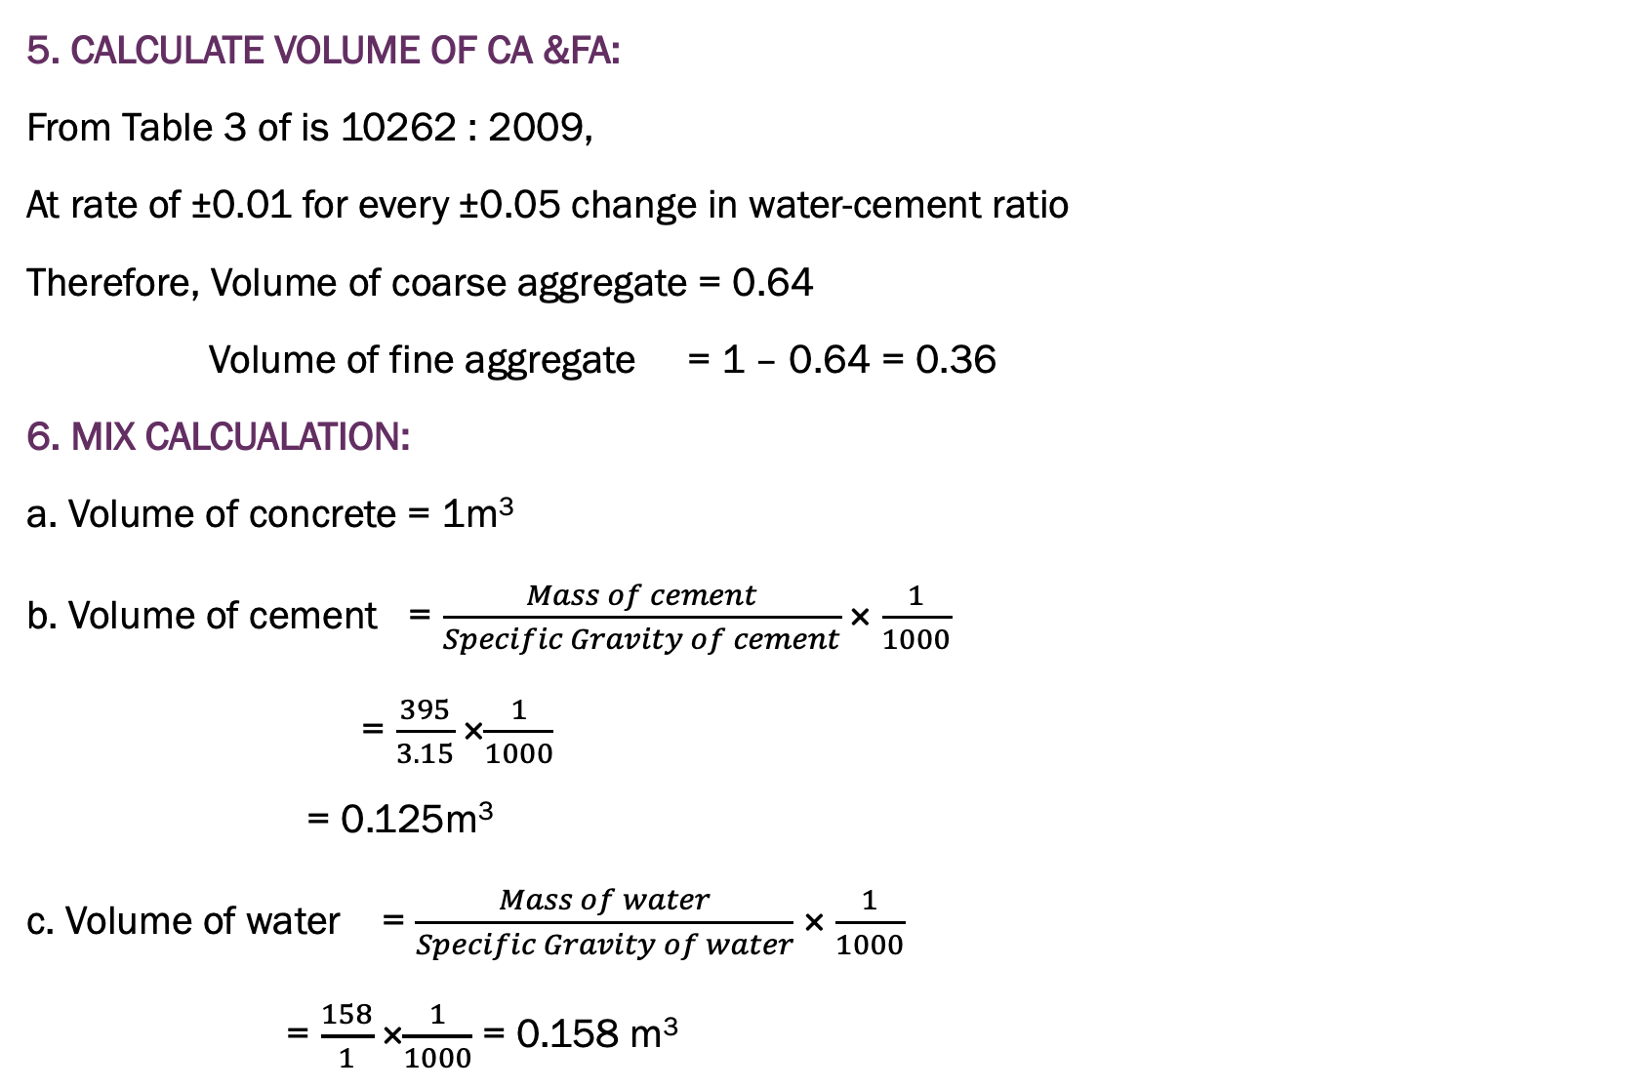
5. CALCULATE VOLUME OF CA &FA:
From Table 3 of is 10262 : 2009,
At rate of ±0.01 for every ±0.05 change in water-cement ratio
Therefore, Volume of coarse aggregate = 0.64
Volume of fine aggregate = 1 – 0.64 = 0.36
6. MIX CALCUALATION:
a. Volume of concrete = 1m³
b. Volume of cement = $\frac{Mass of cement}{Specific Gravity of cement}$ × $\frac{1}{1000}$
= $\frac{395}{3.15}$ ×$\frac{1}{1000}$
= 0.125m³
c. Volume of water = $\frac{Mass of water}{Specific Gravity of water}$ × $\frac{1}{1000}$
= $\frac{158}{1}$ ×$\frac{1}{1000}$ = 0.158 m³

Slide 32
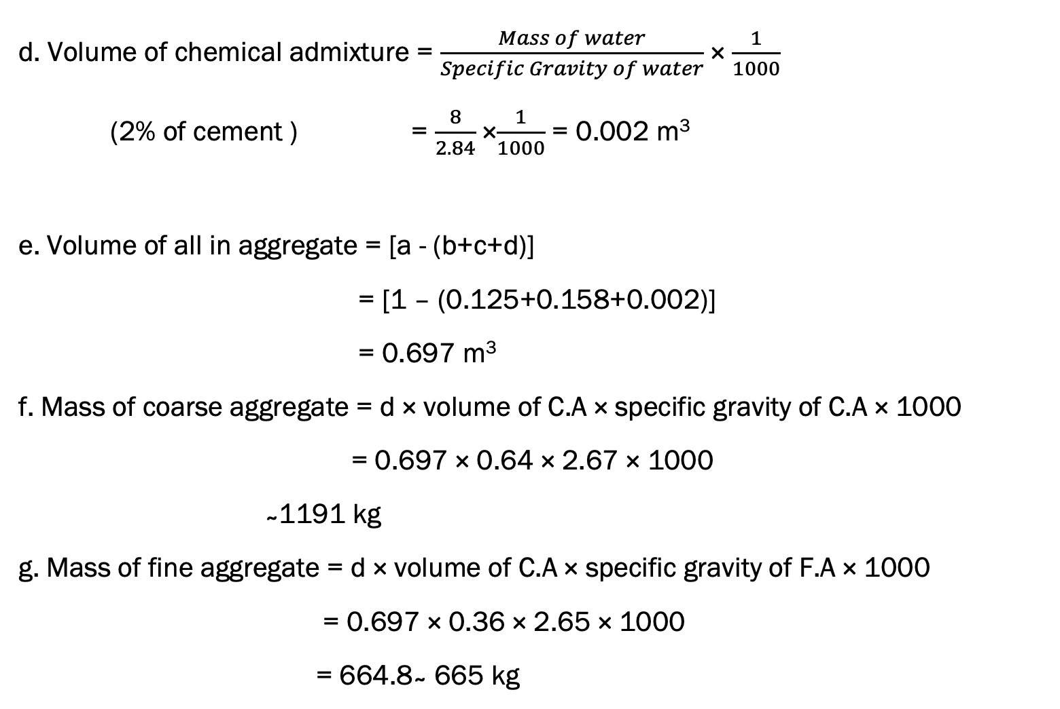
d. Volume of chemical admixture = $\frac{Mass of water}{Specific Gravity of water}$ × $\frac{1}{1000}$
(2% of cement ) = $\frac{8}{2.84}$ ×$\frac{1}{1000}$ = 0.002 m³
e. Volume of all in aggregate = [a - (b+c+d)]
= [1 – (0.125+0.158+0.002)]
= 0.697 m³
f. Mass of coarse aggregate = d × volume of C.A × specific gravity of C.A × 1000
= 0.697 × 0.64 × 2.67 × 1000
̴ 1191 kg
g. Mass of fine aggregate = d × volume of C.A × specific gravity of F.A × 1000
= 0.697 × 0.36 × 2.65 × 1000
= 664.8 ̴ 665 kg

Slide 33
7. RESULT:
a. Cement = 395 kg/m³
b. Water = 158 litres
c. F.A = 665 kg
d. C.A = 1191kg
e. w/c ratio = 0.40
f. Chemical Admixture = 8kg
g. Mix Proportion =395: 665 : 1191
= 1: 1.68: 3.01
˜ 1: 1.5: 3

Slide 34
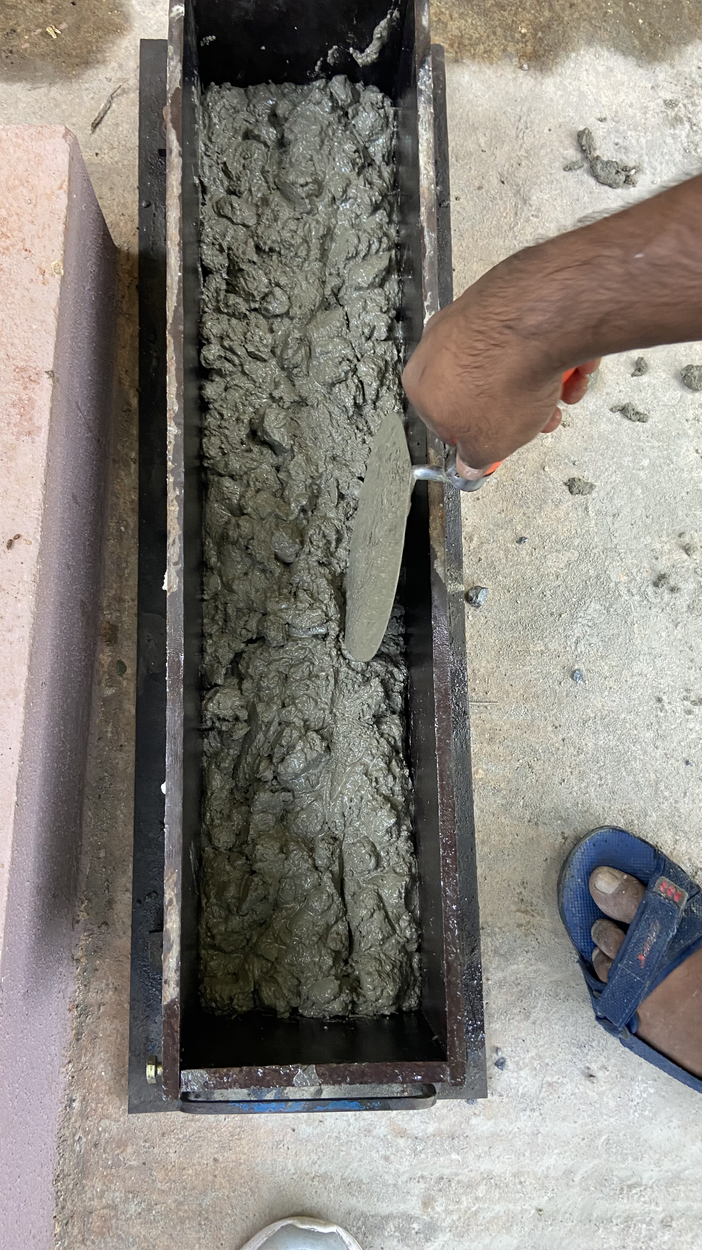
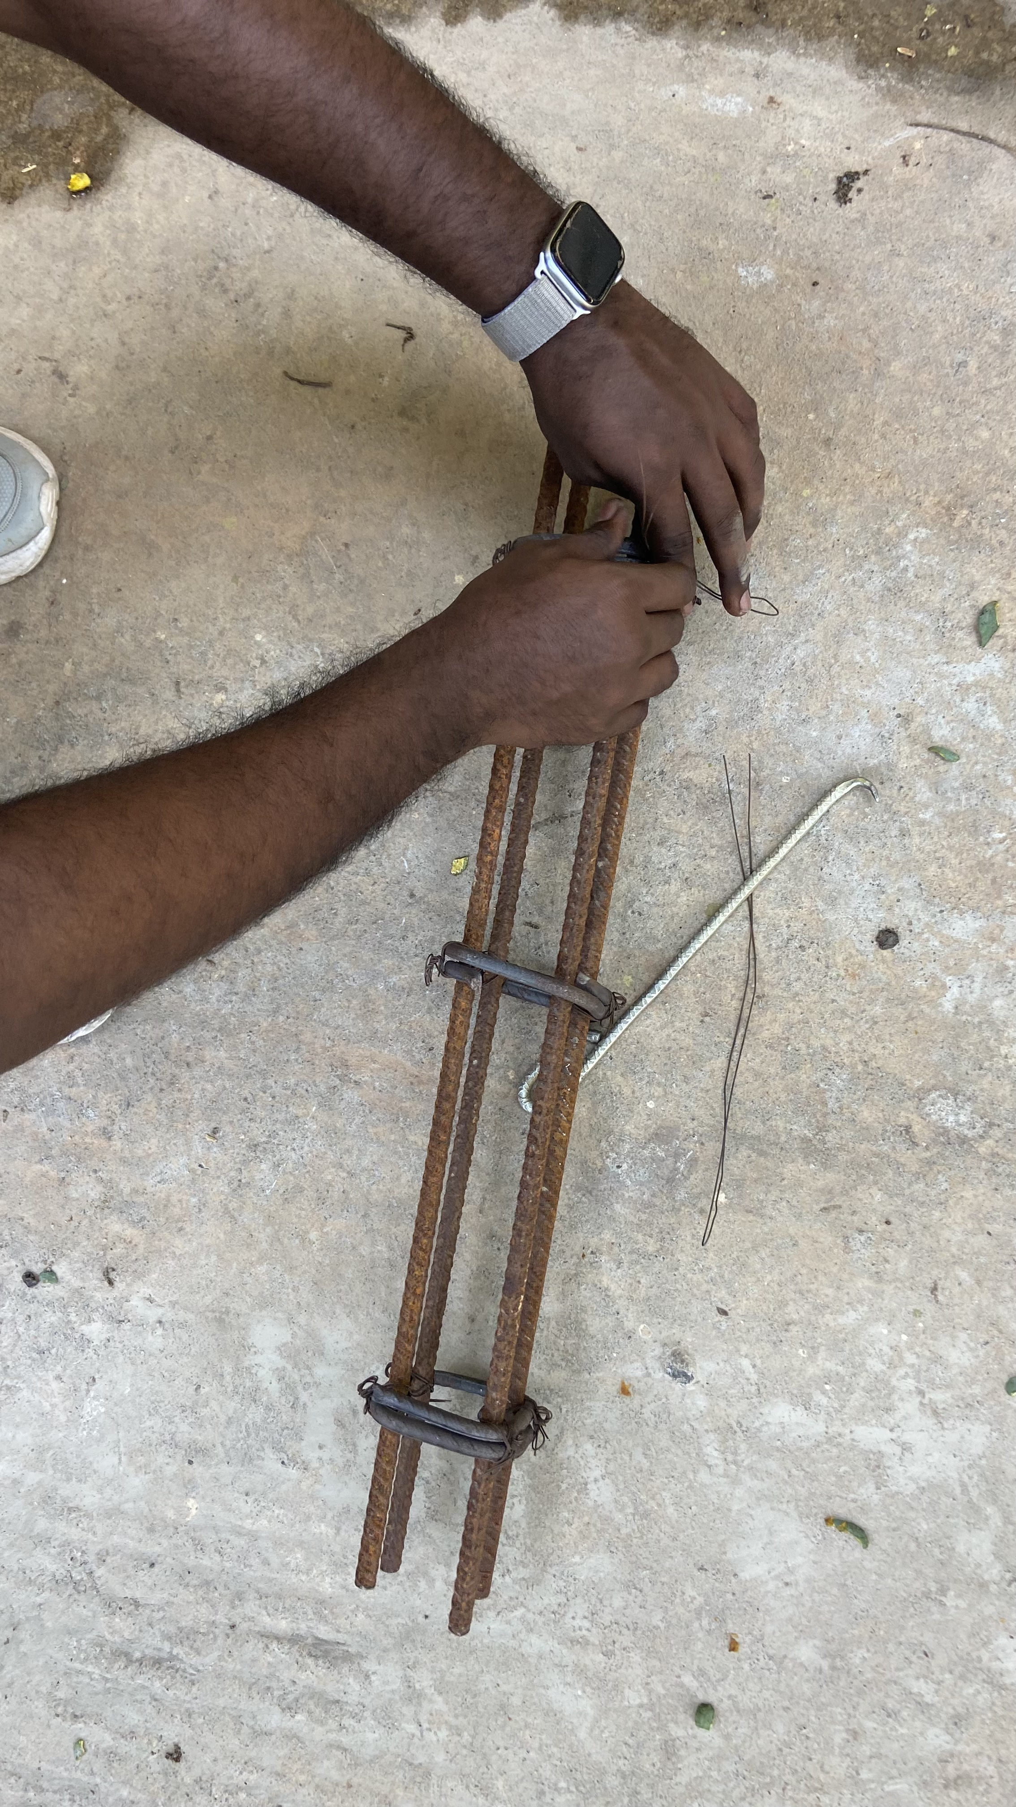
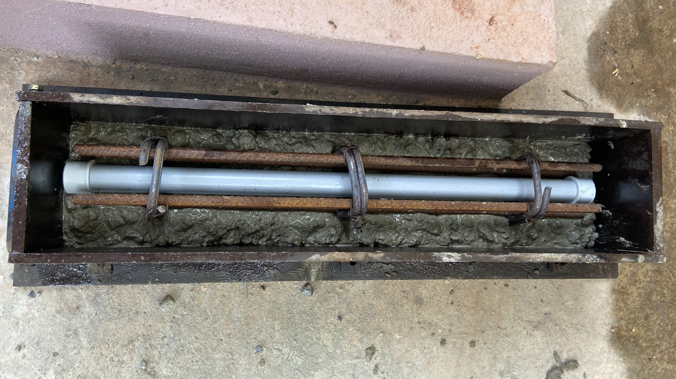
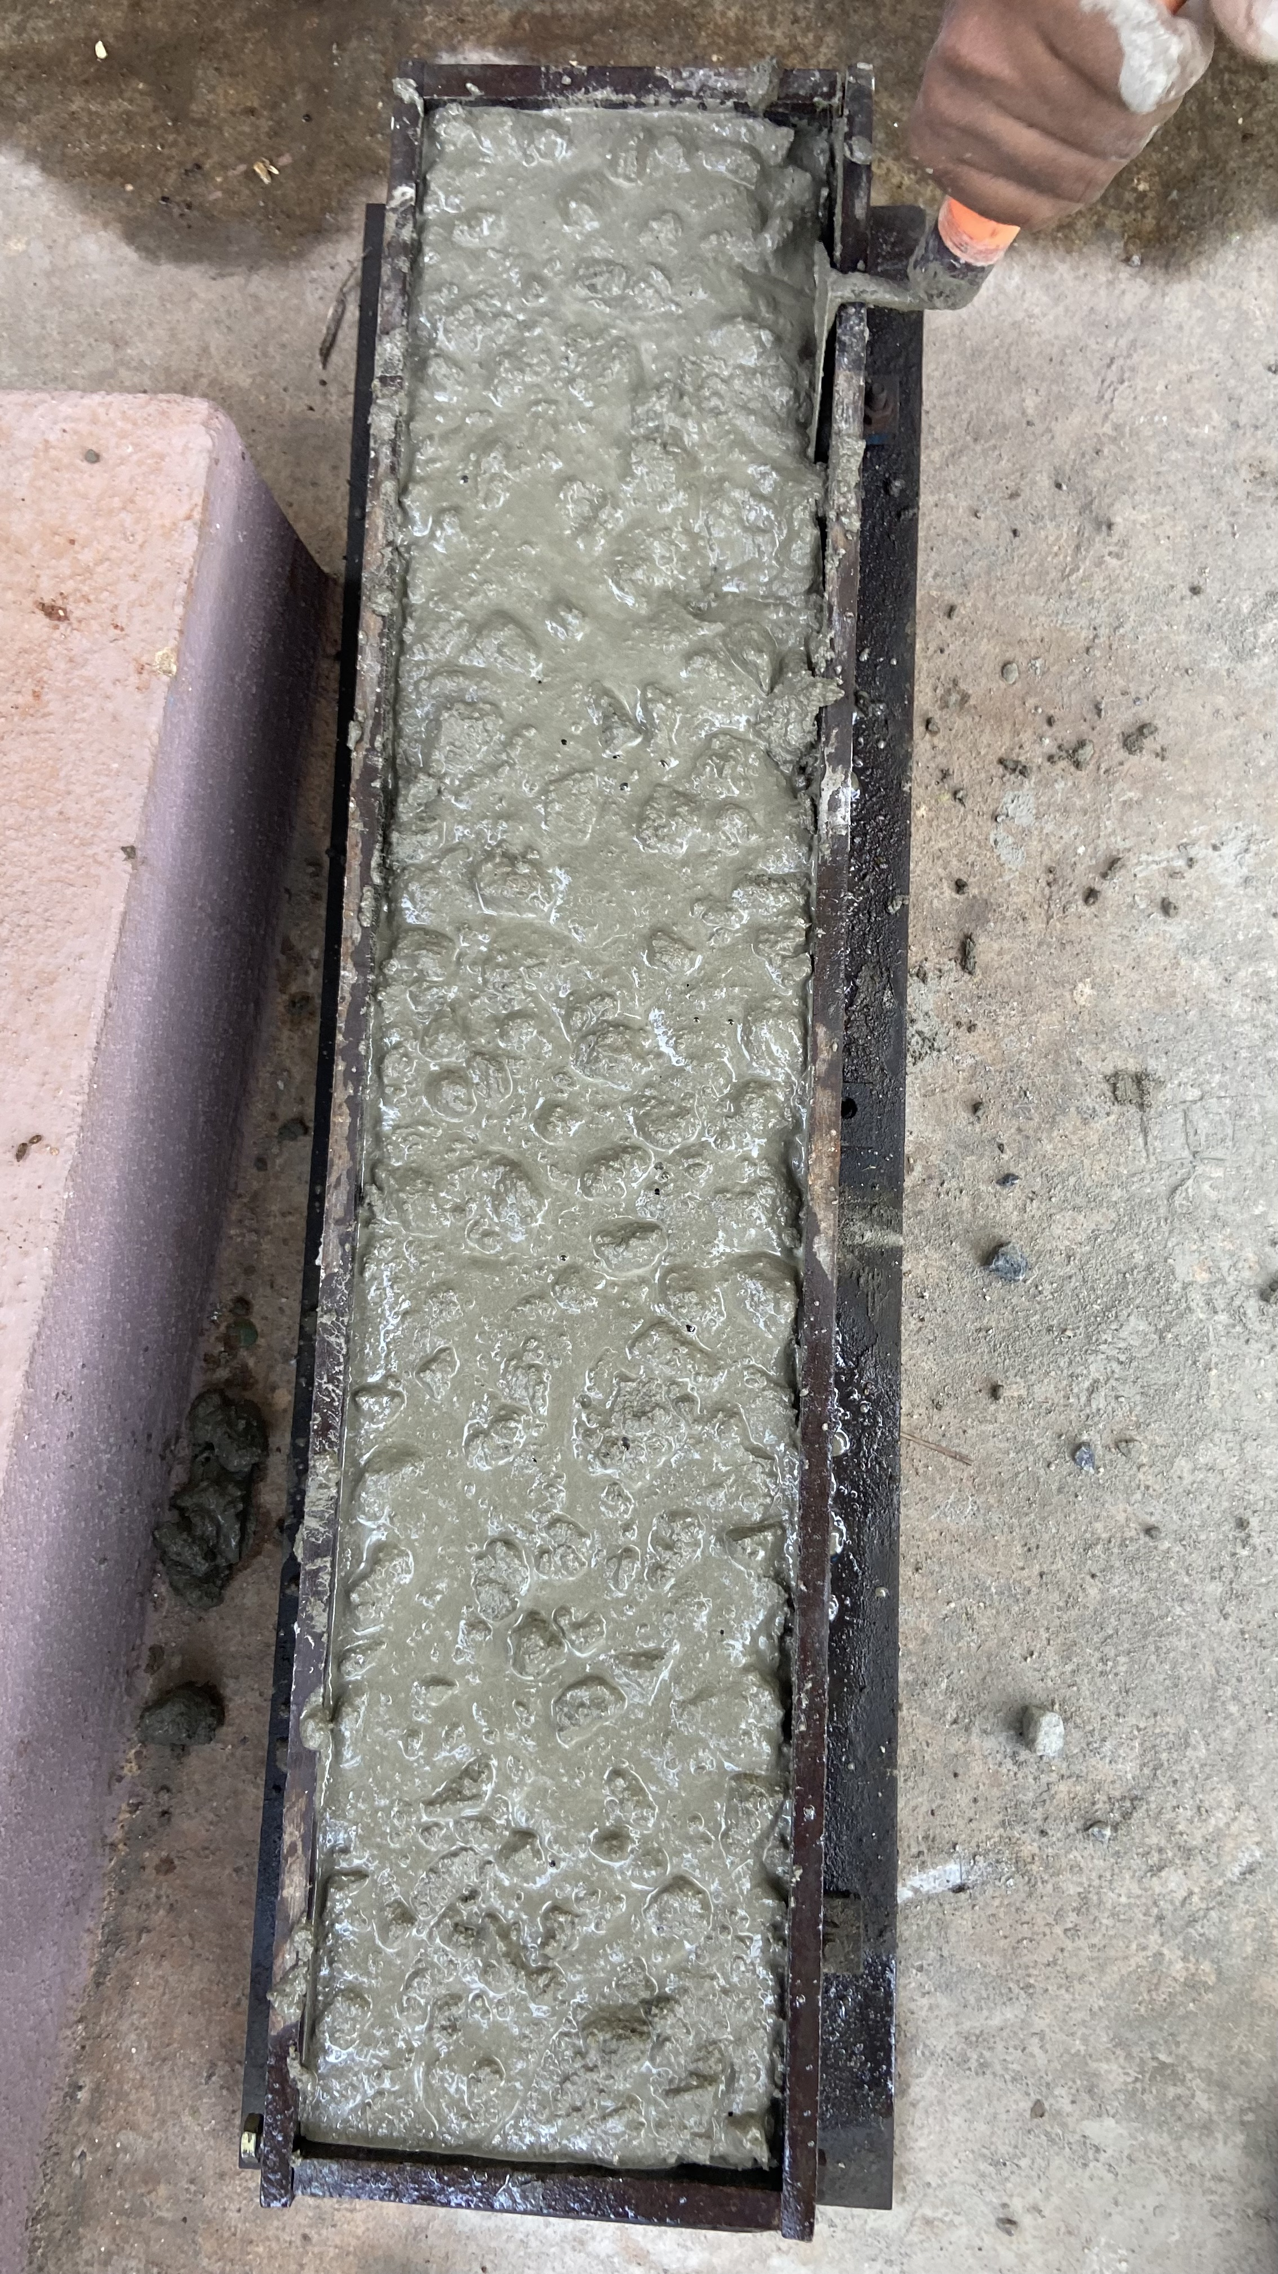
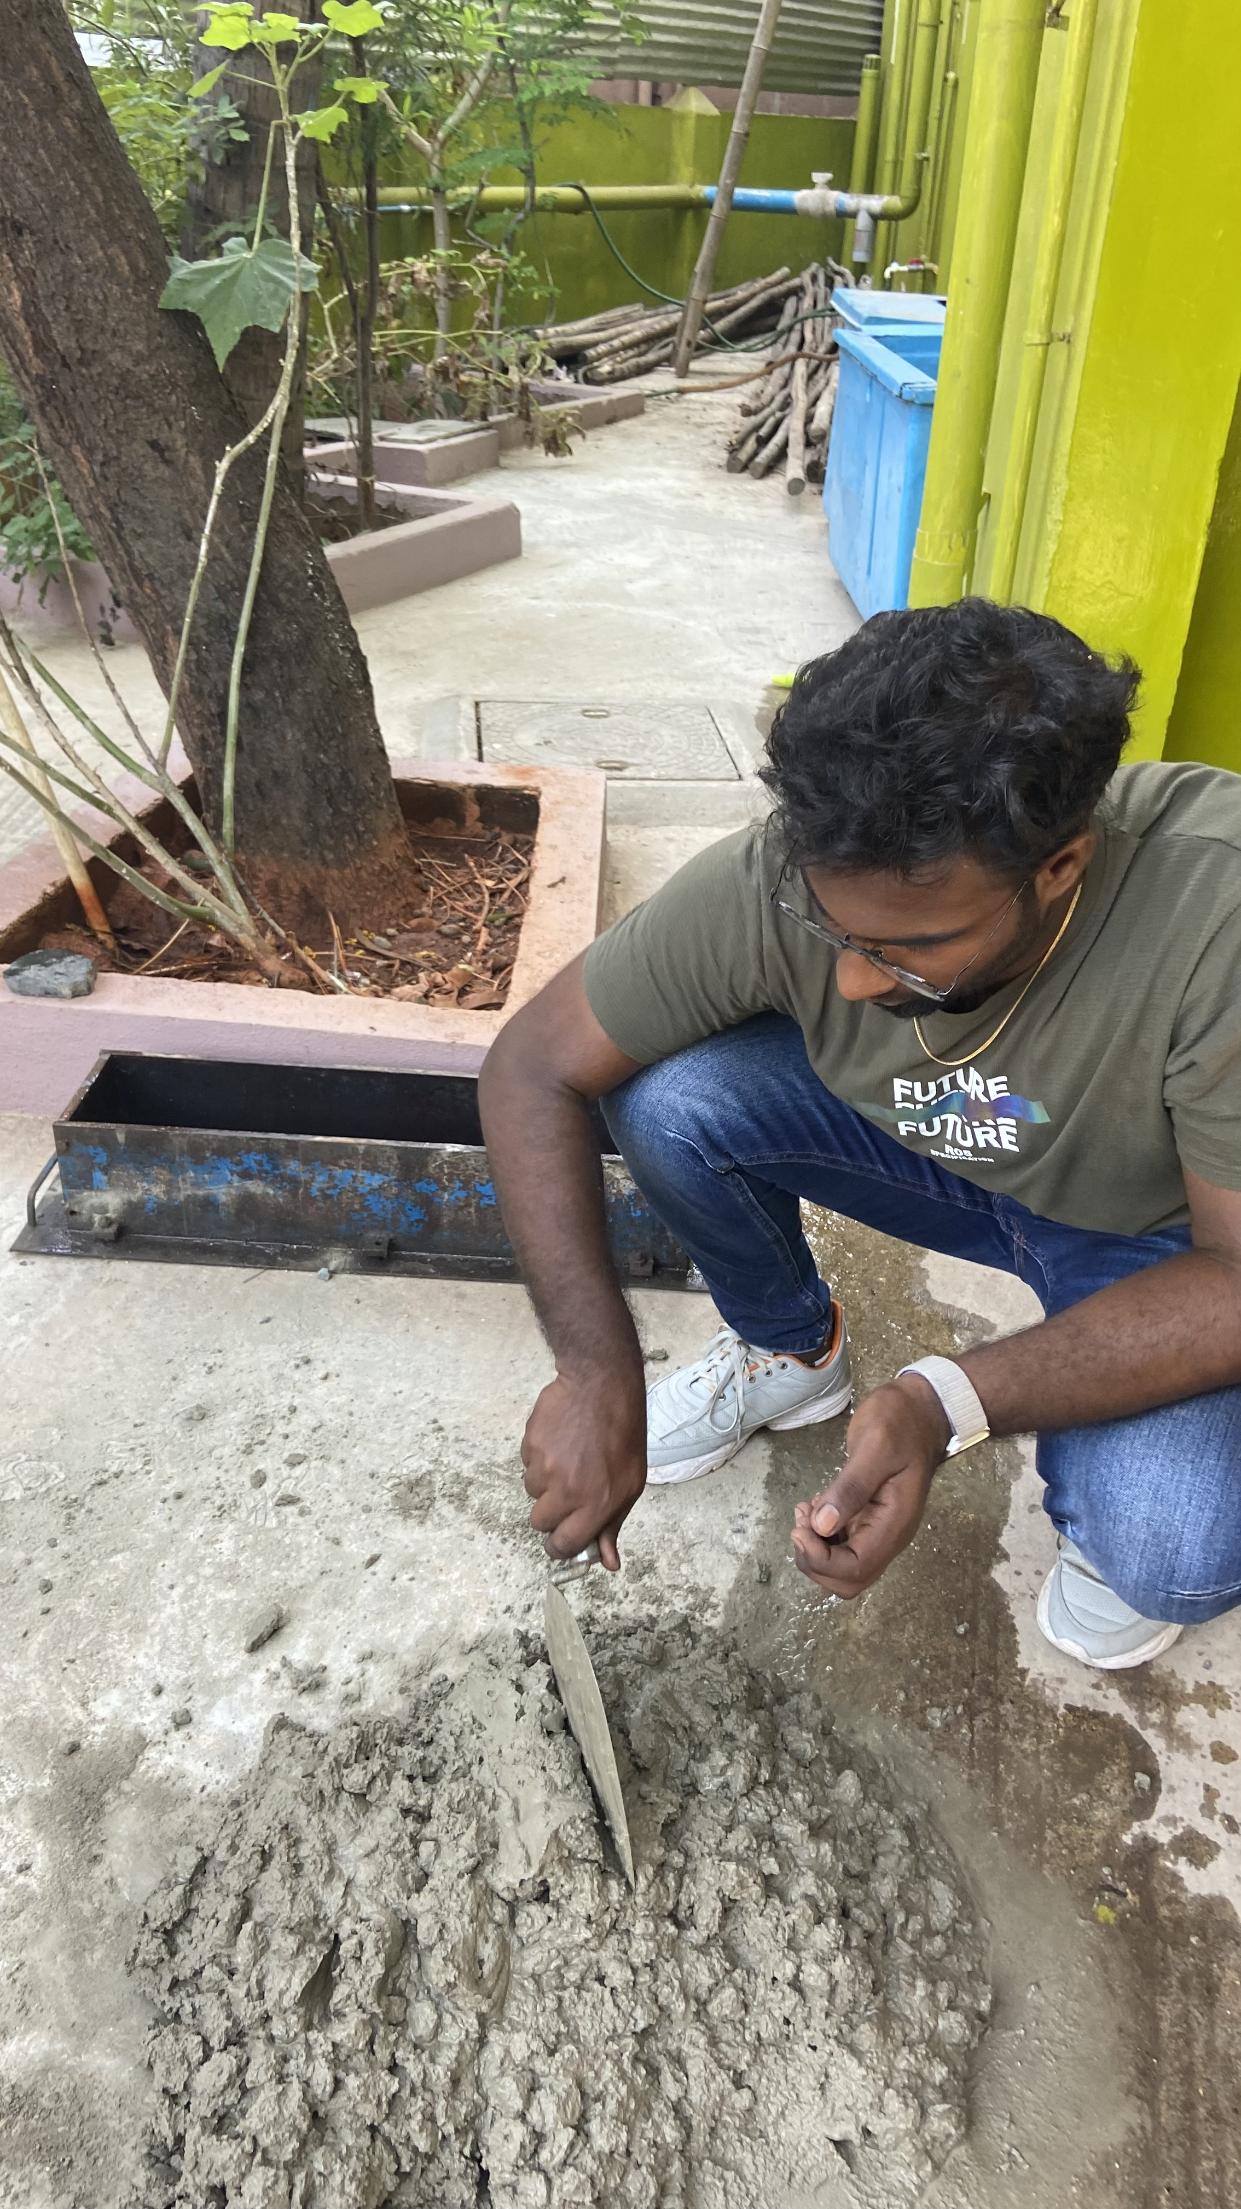
EXPERIMENTAL WORK
BEAM CASTING PHOTOS

Slide 35
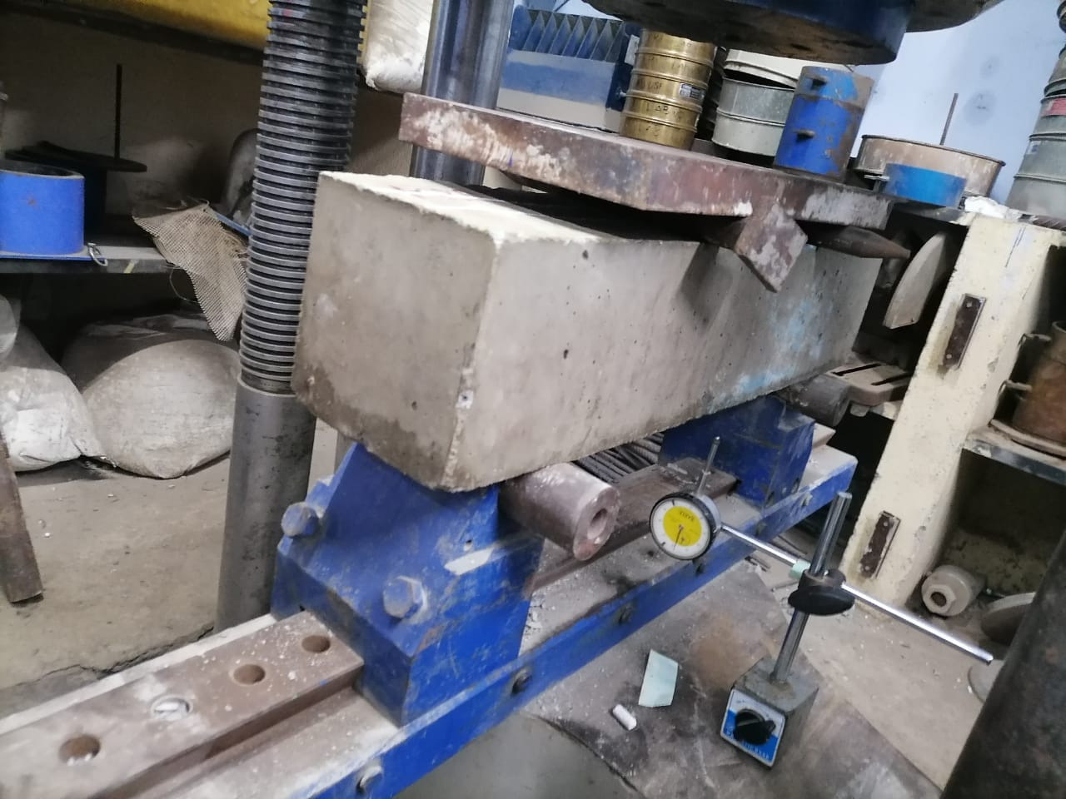
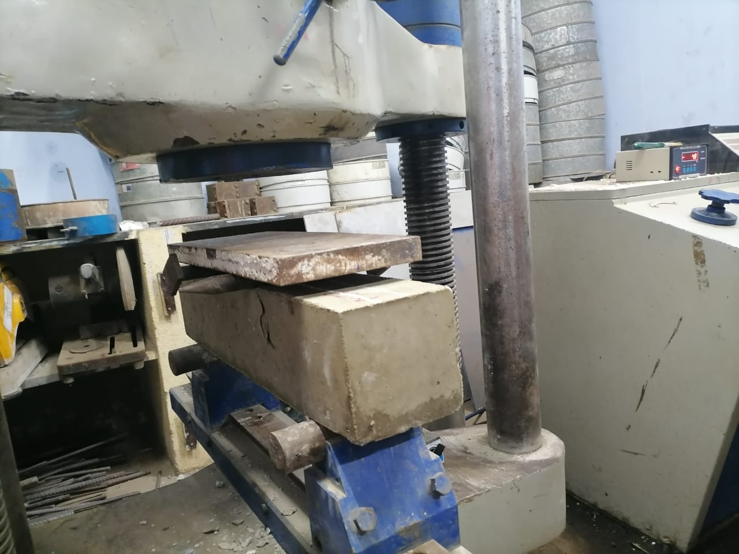
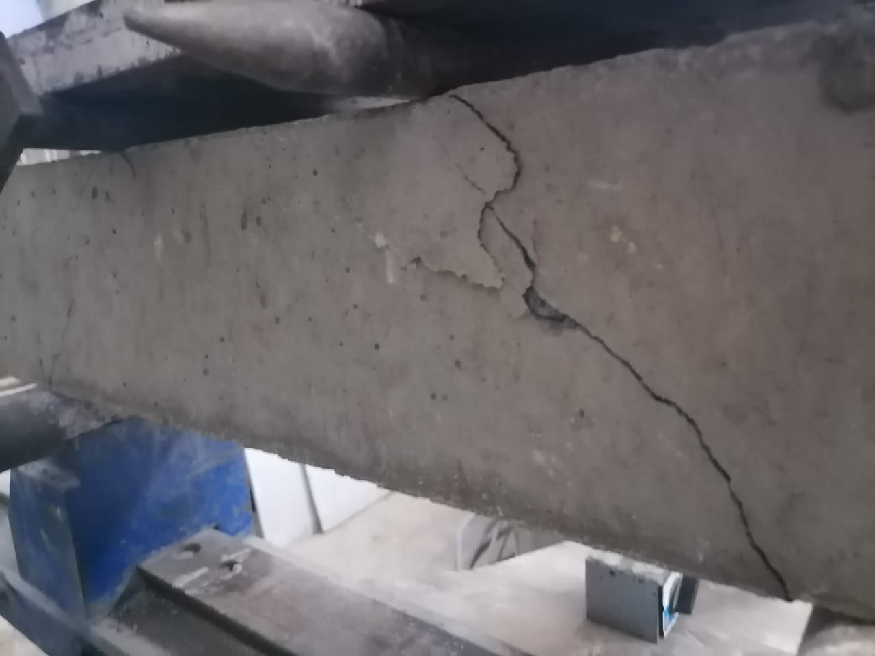
TESTING FOR FLEXURAL STRENGTH
TESTING PHOTOS

Slide 36




FLEXURAL STRENGTH OF CB AT 7 DAYS
SPECIMEN DETAILS | FLEXURAL STRENGTH (N/mm²) at 7 DAYS
CB1 | 1.8
CB2 | 1.17
CB3 | 2.32
AVERAGE | 1.76
FLEXURAL STRENGTH (N/mm²) at 7 DAYS
FLEXURAL STRENGTH IN (N/mm^2)
2.5
2
2.32
1.5
1.8
1.76
1
1.17
0.5
0
CB1
CB2
CB3
AVERAGE

Slide 37




FLEXURAL STRENGTH OF RB AT 7 DAYS
SPECIMEN DETAILS | FLEXURAL STRENGTH (N/mm²) at 7 DAYS
RB1 | 1.12
RB2 | 1.53
RB3 | 1.78
AVERAGE | 1.48
FLEXURAL STRENGTH IN (N/mm^2)
FLEXURAL STRENGTH (N/mm2) at 7 DAYS
2
1.8
1.6
1.4
1.2
1
0.8
0.6
0.4
0.2
0
1.78
1.53
1.48
1.12
RB1 RB2 RB3 AVERAGE

Slide 38
FLEXURAL STRENGTH OF CB VS RB AT 7 DAYS
FLEXURAL STRENGTH IN (N/mm^2)
COMPARISON GRAPH FOR 7 DAYS
1.76
1.8
1.75
1.7
1.65
1.6
1.55
1.5
1.45
1.4
1.35
1.3
1.48
CONVENTIONAL BEAM RUBBERIZED BEAM

Slide 39




FLEXURAL STRENGTH OF CB AT 14 DAYS
SPECIMEN DETAILS | FLEXURAL STRENGTH (N/mm²) at 14 DAYS
CB4 | 2.52
CB5 | 1.85
CB6 | 3.03
AVERAGE | 2.47
FLEXURAL STRENGTH IN (N/mm^2)
FLEXURAL STRENGTH (N/mm²) at 14 DAYS
3.5
3.03
3
2.5
2
2.52
2.47
1.85
1.5
1
0.5
0
CB4
CB5
CB6
AVERAGE

Slide 40




FLEXURAL STRENGTH OF RB AT 14 DAYS
FLEXURAL STRENGTH IN (N/mm^2)
FLEXURAL STRENGTH (N/mm²) at 14 DAYS
3.17
SPECIMEN DETAILS | FLEXURAL STRENGTH (N/mm²) at 14 DAYS
RB4 | 2.82
RB5 | 2.94
RB6 | 3.17
AVERAGE | 2.98
3.2
3.1
3
2.94
2.98
2.9
2.82
2.8
2.7
2.6
RB4
RB5
RB6
AVERAGE

Slide 41
FLEXURAL STRENGTH OF CB VS RB AT 14 DAYS
FLEXURAL STRENGTH IN (N/mm^2)

Slide 42




FLEXURAL STRENGTH OF CB AT 28 DAYS
FLEXURAL STRENGTH IN (N/mm^2)
FLEXURAL STRENGTH (N/mm²) at 28 DAYS
SPECIMEN DETAILS | FLEXURAL STRENGTH (N/mm²) at 28 DAYS
CB7 | 4.53
CB8 | 3.1
CB9 | 5.85
AVERAGE | 4.49
7
6
5.85
5 4.53
4.49
4
3.1
3
2
1
0
CB7
CB8
CB9
AVERAGE

Slide 43



FLEXURAL STRENGTH OF RB AT 28 DAYS
FLEXURAL STRENGTH IN (N/mm^2)
FLEXURAL STRENGTH (N/mm²) at 28 DAYS
SPECIMEN DETAILS | FLEXURAL STRENGTH (N/mm²) at 28 DAYS
RB7 | 4.72
RB8 | 4.72
RB9 | 5.09
AVERAGE | 4.84
5.2
5.1
5
4.9
5.09
4.84
4.8
4.72
4.72
4.7
4.6
4.5
RB7
RB8
RB9
AVERAGE

Slide 44
FLEXURAL STRENGTH OF CB VS RB AT 28 DAYS
FLEXURAL STRENGTH IN (N/mm^2)
COMPARISION GRAPH FOR 28 DAYS
4.9
4.84
4.8
4.7
4.6
4.49
4.5
4.4
4.3
CONVENTIONAL BEAM
RUBBERIZED BEAM

Slide 45
CONCLUSION
Based on the presented experimental program, the following conclusions can be offered.
The installation of PVC pipes in reinforced concrete beams increases the strength and rigidity of the beams depending on sizes and locations of these pipes.
There is no need to take any precautions regarding the beam with central pipe if the diameter of the pipe is about or less than one third of the beams width. The most preferable location to install pipe in reinforced concrete moderate deep beams is at the center of the beams away from the tension reinforcement in order to avoid bond failure.
Experimental investigation revealed that rubberized beam can withstand approximately the same stress as that of conventional beam and their strength increased gradually with the curing period.
Therefore, beams embedded with PVC pipe filled with crumbled rubber powder can replace conventional beam due to its economy, strength and the PVC pipe can serve the purpose of conduit pipes for electrical wire installation.

Slide 46
REFERENCES
[1] M. Elchalakani, T. Aly, E. Abu-Aisheh, Mechanical properties of rubberised concrete for road side barriers, Aust. J. Civ. Eng. 14 (2016) 1–12, https://doi.org/10.1080/ 14488353.2015.1092631.
[2] M. Elchalakani, High strength rubberised concrete contains silica fumes for the construction of sustainable roadside barriers, Int. J. Struct. 1 (2015) 10–28.
[3] A.P.C. Duarte, N. Silvestre, J. de Brito, E. Júlio, J.D. Silvestre, On the sustainability of rubberized concrete filled square steel tubular columns, J. Clean. Prod. 170 (2018) 510–521, https://doi.org/10.1016/j.jclepro.2017.09.131.
[4] A.P.C. Duarte, B.A. Silva, N. Silvestre, J. de Brito, E. Júlio, J.M. Castro, Tests and design of short steel tubes filled with rubberised concrete, Eng. Struct. 112 (2016) 274–286, https://doi.org/10.1016/j.engstruct.2016.01.018.
[5] A. Gholampour, T. Ozbakkaloglu, R. Hassanli, Rubberised concrete under confinement, Concr. Aust. 40 (2017) 49–53.
[6] A.C. Ho, A. Turatsinze, R. Hameed, D.C. Vu, Effects of rubber aggregates from grinded used tyres on the concrete resistance to cracking, J. Clean. Prod. 23 (2012) 209–215, https://doi.org/10.1016/j.jclepro.2011.09.016
[7] R.H. Grzebieta, C. Tingvall, Roadside crash barrier testing, Soc. Automot. Eng. Aust. (2002).
[8] F.A. Berg, R. Zou Motorcycle Impacts Into Roadside Barriers – Real-World Accident Studies, Crash Tests and Simulations Carried Out in Germany and Australia, n.d. pp. 1–13.

Slide 47
[9] A.O. Atahan, U.K. Sevim, Testing and comparison of concrete barriers containing shredded waste tire chips, Mater. Lett. 62 (2008) 3754–3757, https://doi.org/10. 1016/j.matlet.2008.04.068.
[10] M. Elchalakani, M.F. Hassanein, A. Karrech, B. Yang, Experimental investigation of rubberised concrete- filled double skin square tubular columns under axial compression, Eng. Struct. 171 (2018) 730–746, https://doi.org/10.1016/j.engstruct. 2018.05.123.
[11] X.L. Zhao, R. Grzebieta, Strength and ductility of concrete filled double skin (SHS inner and SHS outer) tubes, Thin-Walled Struct. 40 (2002) 199–213, https://doi. org/10.1016/S0263-8231(01)00060-X
[12] S. Morino, M. Uchikoshi, I. Yamaguchi, Concrete-filled steel tube column system-its advantages, Steel Struct. 1 (2001) 33–44.
[13] M. Elchalakani, M.F. Hassanein, A. Karrech, S. Fawzia, B. Yang, V.I. Patel, Experimental tests and design of rubberised concrete-filled double skin circular tubular short columns, Structures 15 (2018) 196–210, https://doi.org/10.1016/j. istruc.2018.07.004.
[14] M. Elchalakani, R. Grzebieta, X.-L. Zhao, Plastic collapse analysis of slender circular tubes subjected to large deformation pure bending, Adv. Struct. Eng. 5 (2002) 241–257, https://doi.org/10.1260/136943302320974617.
[15] M. Elchalakani, X.L. Zhao, R. Grzebieta, Bending tests to determine slenderness limits for cold-formed circular hollow sections, J. Constr. Steel Res. 58 (2002) 1407–1430, https://doi.org/10.1016/S0143-974X(01)00106-7.

Slide 48
THANK YOU

